Slide 1
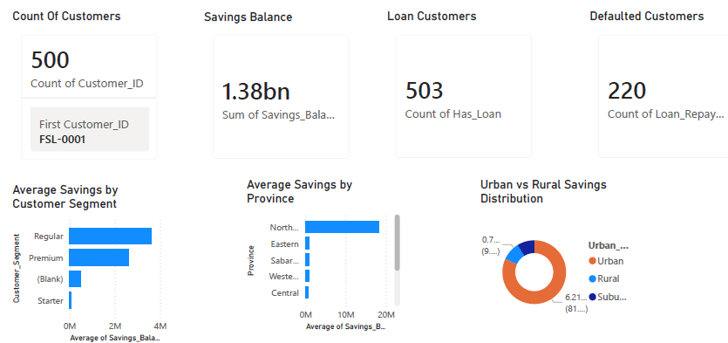
FinSight Lanka – Customer Data Analysis
Analytics Trainee Assessment
Dinujaya Fernando
2026.05.25
Dialog Finance PLC

Slide 2
BUSINESS OBJECTIVE
Analyze customer savings behavior and financial patterns
Evaluate loan portfolio performance and credit risk
Identify digital engagement and mobile app usage
Improve customer segmentation and targeting strategies
Identify cross-sell opportunities for financial products

Slide 3
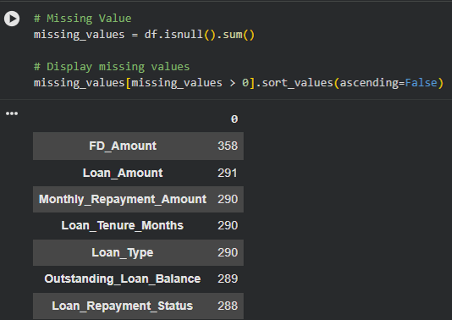
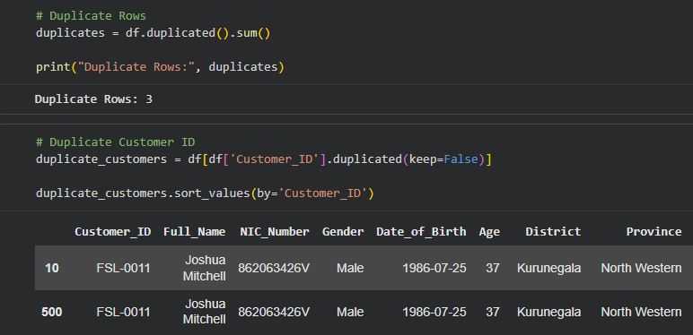
DATA CLEANING & METHODOLOGY
Removed duplicate records to ensure data accuracy
Handled missing and inconsistent values appropriately
Validated financial fields such as loan and savings balances
The analysis was performed using Google Colab as the development environment
Libraries used: Pandas and NumPy for data cleaning and manipulation

Slide 4
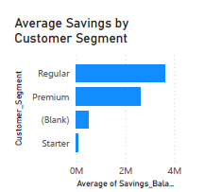
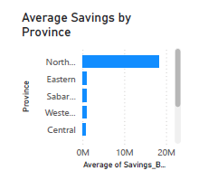
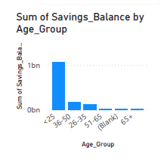
Customer Savings Behavior Analysis
Mid-career customers (36–50) hold the highest total savings across all segments
Urban customers show significantly higher average savings compared to rural customers
Certain high-value customer segments demonstrate stronger financial stability and deposit behavior

Slide 5
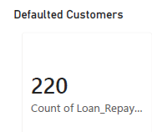
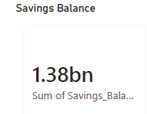
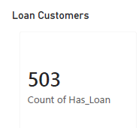
Loan Portfolio & Risk Analysis
Customers with high debt-to-savings ratios represent elevated financial risk exposure
Default behavior varies across loan types, indicating differences in credit risk quality
High-risk customers are often associated with lower savings and higher loan dependency
Debt-to-Savings Ratio = Loan Balance / Savings Balance

Slide 6
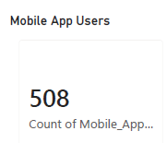
Digital Engagement & Cross-Sell Opportunity
Mobile app users maintain higher average savings balances compared to non-users
Digital engagement is strongly correlated with higher customer lifetime value
Digitally active customers demonstrate stronger financial engagement and product usage
Cross-sell Rate = Customers with multiple products / Total customers × 100

Slide 7
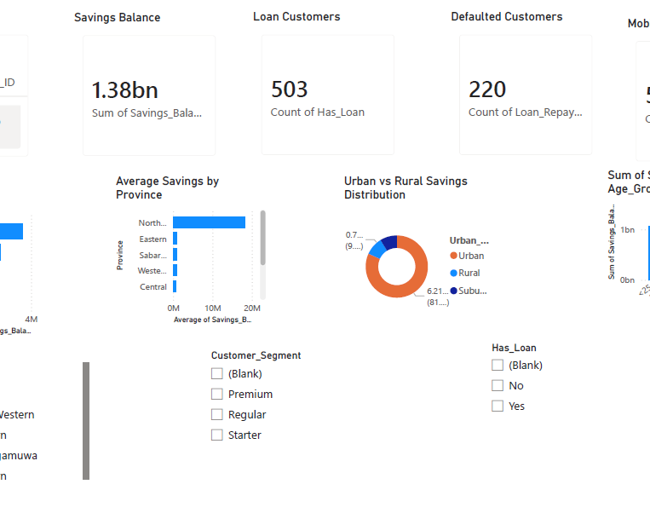
Key Performance Indicators (KPIs)
Total Savings Deposit growth
Loan Penetration Lending expansion
Default Rate Risk monitoring
Mobile Adoption Digital engagement
Cross-Sell Opportunity Revenue growth

Slide 8
Strategic Recommendations
Strengthen Digital Engagement Strategy
Mobile app users demonstrate higher savings balances and stronger engagement
2. Expand Cross-Sell Programs
Promote fixed deposits, loans, and insurance products to existing customers
3. Improve Credit Risk Monitoring
Implement early warning systems for risky borrowers
4. Enhance Customer Segmentation Strategy
Different customer groups show distinct financial behaviors across regions and age groups

Slide 9
Limitations & Critical Evaluation
Limitation
Impact
No transaction-level data
Small dataset size (508 records) (Medium)
Assumptions used for classification (Medium)
Limits behavioral trend analysis and customer activity insights
Limits generalization to the wider population
May reduce accuracy of savings and risk categorization

Slide 10
FINAL CONCLUSION
This analysis provides a comprehensive view of customer savings behavior, loan risk, and digital engagement within FinSight Lanka
Data-driven decision-making can significantly enhance customer value, operational efficiency, and overall business profitability
The dashboard enables continuous monitoring of key financial and behavioral KPIs for better strategic planning
Thank You!

